Slide 1

चरैवेति, चरैवेति
Keep progressing to attain a higher self.
avinash.bhagat@lpu.co.in Avinash Bhagat 9463281930

Slide 2
CAP275: DATA COMMUNICATION AND NETWORKING
Lecture # 0
avinash.bhagat@lpu.co.in Avinash Bhagat 9463281930

Slide 3
Course Related Information
introductory course in computer networks.
data communication and various other fundamental concepts of data communication.
OSI reference model and TCP/IP network architecture models.
each layer of these models
various security protocols and techniques used in the computer networks.
Notes:
This is an introductory course in computer networks. The course first introduces the data communication and various other fundamental concepts of data communication.
In particular, it concentrates on the Internet technology and discuss the OSI reference model and TCP/IP network architecture models.
The implementation principles and design issues at each layer of these models will be discussed later in the course.
At the end of the course there will be discussion on various security protocols and techniques used in the computer networks.

Slide 4
Course Outcomes
CO1 :: Recognize the basics of data communication, networking, internet and their importance.
CO2 :: Understand the concepts of data communication, layered model, protocols and interworking between computer networks and switching components.
CO3 :: Determine the various networks using the the logical addressing and by applying subnetting and routing concepts.
CO4 :: Analyze the working of transport and application layer protocols in an IP based networking infrastructure.

Slide 5
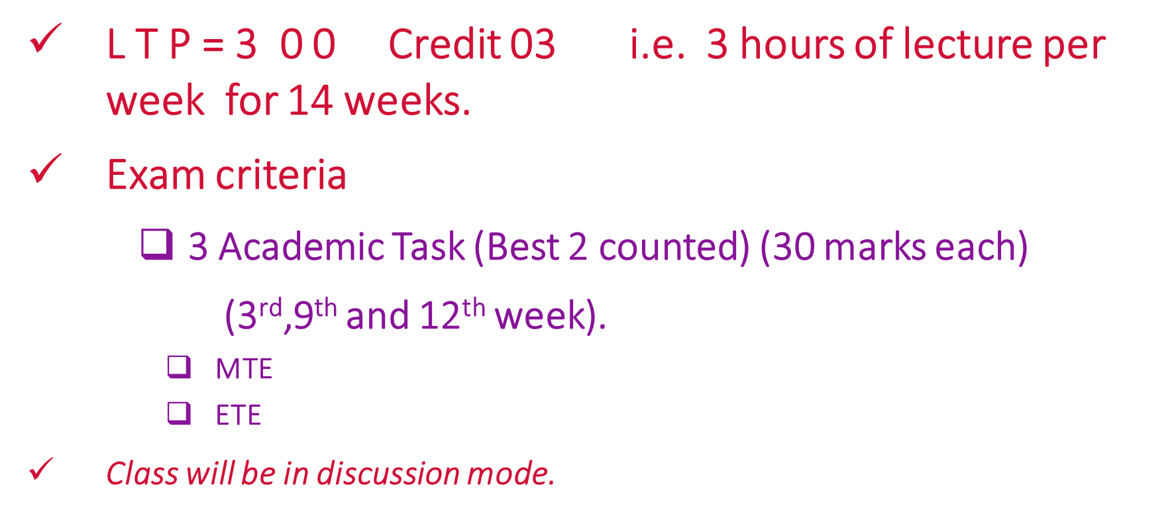
Course Related Information

Slide 6
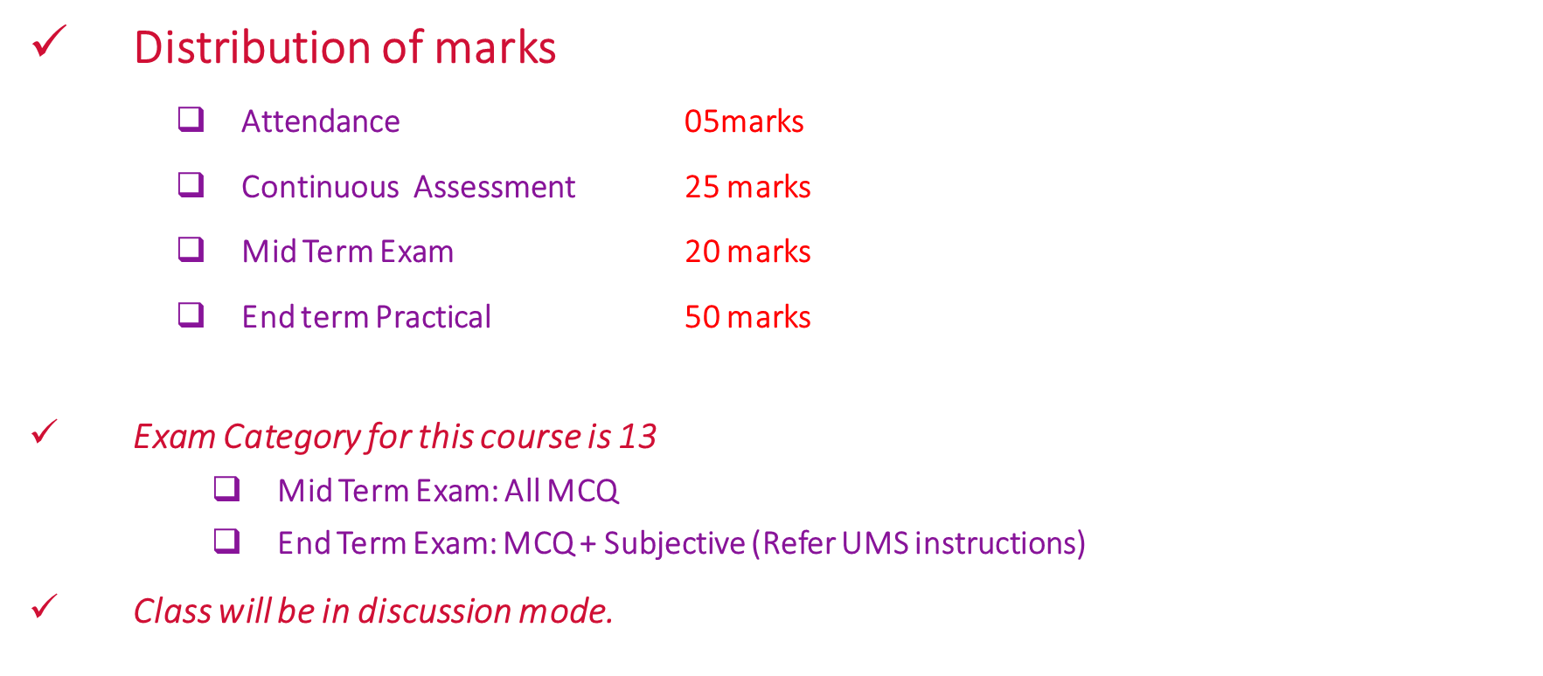
Course Related Information

Slide 7
Course Related Information
What is LTP of the course CAP275?
3-0-1
3-0-0
3-1-0
2-0-1

Slide 8
Course Related Information
How many academic tasks will be there in the course CAP275?
3 Academic Task (Best 2 counted) (30 marks each)
2 Academic Task (Best 2 counted) (30 marks each)
4 Academic Task (Best 3 counted) (50 marks each)
No academic task only MTE and ETE will be there.

Slide 9
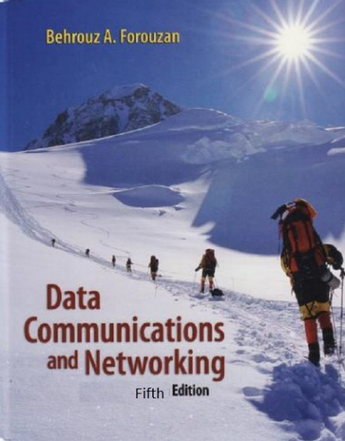
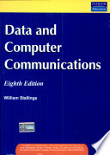
Text and Reference Books
Text Book
DATA COMMUNICATION AND NETWORKING by B.A. FOROUZAN
MCGRAW HILL EDUCATION
Reference Book
DATA AND COMPUTER COMMUNICATIONS by WILLIAM STALLINGS
PEARSONMCGRAW HILL EDUCATION

Slide 10
Course Contents
Unit I
Data communications : characteristics, components, data representation, data flow
Networks : distributed processing, network criteria, types of connections, types of topologies, categories of networks, protocols, standards, standards organizations, internet standards
Network models : the OSI model, layered architecture, layers in the OSI model, TCP/IP protocol suite, addressing mechanisms in layers

Slide 11
Course Contents
Unit II
Physical Layer : analog and digital, analog signals, digital signals, analog versus digital, data rate limit, transmission impairments, line coding, block coding, sampling, transmission mode, modulation of digital data, telephone modems, modulation of analog signal, FDM, WDM, TDM, guided media, unguided media, switching, networking devices

Slide 12
Course Contents
Unit III
Data Link Layer : error detection and correction, types of errors, error detection and correction techniques, data link control and protocols, flow and error control, stop-and-wait ARQ, go-back-n ARQ, selective repeat ARQ, HDLC, point-to-point access, point–to-point protocol (PPP), PPP stack, multiple access, random access, controlled access, channelization

Slide 13
Course Contents
Unit IV
Network Layer : classful addressing, logical addressing, IPv4, IPv4 frame format and functions, subnets, FLSM, VLSM, classless inter domain routing (CIDR), public and private addresses, network address translation (NAT), IPv6, basic routing (or forwarding) mechanism, unicast routing protocols, distance vector routing, RIP, link state routing, OSPF, path vector routing, BGP, overview of multicast routing

Slide 14
Course Contents
Unit V
Transport layer : process-to-process delivery, port addresses, socket address, user datagram protocol (UDP), transmission control protocol (TCP), 3-way handshaking, SCTP, data traffic, traffic descriptors, congestion control, quality of service, techniques to improve QoS

Slide 15
Course Contents
Unit VI
Application layer and network security : domain name system (DNS), Dynamic Host Configuration Protocol (DHCP), remote logging, TELNET, electronic mail, file transfer, WWW, HTTP, network management system, simple network management protocol (SNMP)
Network security : cryptography, symmetric key cryptography, public key cryptography, security services, IPSec, VPN, firewalls

Slide 16
Informative Videos link
  Journey of my letter
  Apps helpful in our day to day work
  Helpful Gadgets

Slide 17

See you in next class

